Slide 1
CONGRATULATIONS, YOU’VE BEEN ELECTED: NOW WHAT DO YOU DO?
APRIL 24, 2023

Slide 2
Don Borut, former E.D. of NLC
“Running for public office at the local level is an irrational and unnatural act. You permit yourself to be scrutinized more than any blood cell under a microscope, for below market pay, so that citizens can call you day and night. And for what? The right to make decisions that will tick off half the folks in town.”

Slide 3
Don Borut, former E.D. of NLC
“So why do you do it? Basically, to make a difference in your community and improve the quality of life for your citizens. Do you like making tough decisions that effect peoples lives? Probably no more than anyone else, but you do it. Do you have a strong ego? Of course, because that is essential to leadership and explaining your decisions”

Slide 4
Some General Observations
Sworn in to be sworn at
You have not changed, yet…
You have fewer rights than you did the night before the election
You have NOT just committed to three meetings per month
This job impacts your professional life, personal life, and your family’s life
Your decisions have implications
You will be a different person when you leave office

Slide 5
More Observations
If you have everyone around you happy, you’re not doing it right
Your new “friends” may not be your “friends”
You are not just responsible for your campaign promises
Everything takes longer, and is harder than you expect – by design
There are very few original and new ideas
“If it was easy, it would have already been done”
The boring stuff is the most important

Slide 6
Keep the Big Picture in Mind
Understand your role in leading and governing your city
Differentiate between and balance individual short-term goals and long-term community priorities
Make consistent, reasoned decisions that support the community’s strategic vision
Build relationships to successfully lead and achieve personal and community goals

Slide 7
4 “E’s” of Great Governance
According to the National Academy for Public Administration:
Economy: The biggest bang for the taxpayers buck
Efficiency: Most public good in the fastest time and using available resources
Effectiveness: Are we achieving what we set out to do?
Equity: Fair, just and equitable management of public institutions

Slide 8
4 “E’s” Balancing Act
Difficult to balance all 4 E’s
Short Term vs. Long-Term
Making Trade-offs when conflict arise (Values)
Which is more important in your vision of the common good

Slide 9
Above all, local government is “Accountable”
Theory – The “Business” of Governing
“Whenever you have an efficient
Government, you have a dictatorship.”
Harry S. Truman
Why government is not a “business” – a source of great frustration for newly elected officials

Slide 10
Lines of authority are different in local government
Concentrated power in business
vs. diluted power in municipalities
Governing is done collectively
Involves politicking, lobbying,
listening, discussion and compromise
Unless you develop these skills, you
will not succeed in local government

Slide 11
Government is highly regulated; most businesses are not
Although the City of Washington is a home rule municipality, most everything we do requires State authorization

Slide 12
Government decision making is transparent and subject to media scrutiny
Government is subject to sunshine laws
All actions are visible and transparent
Businesses make decisions in private
Transparency can limit creativity and “brainstorming”
Conversely, it may encourage playing to the media or playing to the public through social media platforms

Slide 13
Success in Government cannot be measured by profit
The purpose of a business is to show profit
The purpose of government is not to make money
Municipalities offer services, i.e., traffic regulations, enhancement of public health and safety, i.e., sewer and water
Success is superior efficient services

Slide 14
TO DO:
Check your email and text messages regularly
Do not “Reply All”

Slide 15
Government success is difficult to quantify
Business sells the best product at the
lowest price
A municipality’s relationship with
its residents (customers) is complex
and difficult to measure
Taxes are difficult to equate or compare to service
Result – resident sees no contradiction in asking for better police services while simultaneously demanding lower taxes

Slide 16
MAJOR RESPONSIBLITIES
City Council (Chapter 30 & 31City Code) :
Resolutions & Ordinances
Policies
Sets General Directions
Taxes / Budget
City Administrator:
Accountable to City Council
Hiring & firing (except for police chief)
Oversees daily operations of city staff and city services

Slide 17
Local Government Leadership Changes Regularly (Administrative staff stability is a key to consistent services to the community)
Businesses tend to have more stability and predictability
Every two years, municipal government changes

Slide 18
Media Relations
Always free to talk to Media with your opinion
Official Statements:
- Mayor
- City Administrator
- Department Heads with advice from City Administrator

Slide 19
Meeting Agendas
Agenda Packets posted 48 hours before the date and time of meeting.
Agenda Packets posted on City Website.
Agenda items have thorough narratives by city staff detailing the nature of the discussion.
Prior to every council meeting – Council Report providing updates from every city department.
Updates from City Administrator provided by email when necessary

Slide 20
“Where there is no vision, the people perish…”
Proverbs 29:18

Slide 21
Strategic Planning
“If you don’t know where you are going,
you might wind up someplace else.”
Yogi Berra

Slide 22
“It’s better to look ahead to prepare than to look back and regret.”

Slide 23
Your City Administrator wants you to have all the information to assist you in your decision making….he also offers opinions, when asked.
Guiding Council members - “Without Fear or Favor”

Slide 24
In-house Staff
Give them a chance
Issues are complex
They are professionals/not politicians
Change is natural for municipal staff
Self-preservation – this is their livelihood

Slide 25
Working with professionals
Your attorney
Local government is highly regulated; this may limit what you can legally do
Law is not a science
Objective laws, but subjective personalities enforce and execute the law
Litigation is more about finality than fairness
All litigation ends, but it does not all necessarily end fairly
Over-confident predictions regarding negotiations and/or litigation should be viewed with some suspicion
Consider the worst possible result in weighing settlement of litigation – can you live with that result?

Slide 26
MOST LOCAL GOVERNMENTS…
“I did nothing in particular and
I did it well.”
Gilbert & Sullivan Operetta, Iolanth

Slide 27
“If it moves, regulate it.
If it doesn’t move, kick it and
then regulate it”
Unnamed Federal Bureaucrat

Slide 28
“Many forms of Government have been tried and will be tried in this world of sin and woe. No one pretends that democracy is perfect or all-wise. Indeed, it has been said that democracy is the worst form of Government except all those others that have been tried from time to time.”
Winston Churchill

Slide 29
Words of Wisdom
I WISH THEY WOULD HAVE TOLD ME…

Slide 30
“Democracy means government
by discussion, but it is only effective
if you can stop people talking.”
Clement Atlee

Slide 31
Best Council Member comment ever:
Voting with the majority, Ward 9 Alderperson looked toward Ward 10 Alderperson, saying it’s the council’s job to take care of the entire community, and members should not have what Ward 9 Alderperson described as an “individualistic” mindset.
“We need to get rid of this individualistic, this worship, this idolatry of the individual and recognize that we are a community,” Ward 9 Alderperson said.

Slide 32
It takes five votes to accomplish something

Slide 33
Don’t make promises or commitments before you know both sides of the story (Our city staff doesn’t make mistakes, they make decisions)

Slide 34
Stand firm on principle
Compromise on preferences
Know the difference

Slide 35
“The purpose of life is to contribute in some way to making things better.”
--- Robert F. Kennedy

Slide 36
City of Washington Organizational Chart
Citizens of Washington
City Treasurer
Abbey Strubhar
City Clerk
Valeri Brod
Mayor
Gary Manier
City Council
Michael Brownfield, Ward I
Lilija Stevens, Ward I
Brett Adams, Ward II
Jamie Smith, Ward II
Bobby Martin, Ward III
Brian Butler, Ward III
Mike McIntyre, Ward IV
John Blundy, Ward IV
Finance & Personnel Committee
Chairperson, Brian Butler
Mayor Gary Manier
Alderperson Lilija Stevens
Finance Department
Planning & Development
Public Safety
Chairperson, Brett Adams
Alderperson
Alderperson
Public Safety
City Administrator/Budget Officer
Jim Snider
City Attorney
City Collector
Valeri Brod
Standing Committees
Engineering
HR Manager
Public Works
Chairperson Mike Brownfield
Alderperson John Blundy
Alderperson
Public Works
Admin. Asst.

Slide 37
City Administrator
City Administrator
Jim Snider
Admin. Assistant
Lisa Anderson
HR Manager
Maureen Chambers
Finance Department
Joanie Baxter
Planning & Development
Jon Oliphant
Public Works
Brian Rittenhouse
Engineering
Dennis Carr
Public Safety
Chief of Police Mike McCoy

Slide 38
Finance Department
Finance Director
Joanie Baxter
Customer Service Supervisor
Paula Arnold
Finance Support Specialist
Jill Thomas
Part-Time Accountant
Jeanette Glueck
Customer Service Specialist II
Cara Hanson
Customer Service Specialist I
Shari Parker

Slide 39
Planning and Development
Planning & Development Director
Jon Oliphant
Planner
Aaron Paque
Part-Time Building Inspector (County Contract)
Notes:
Names

Slide 40
Engineering
Director of Engineering
Dennis Carr
Engineering Tech
Ross Fuller
GIS Specialist
Mike Genard
Notes:
Names

Slide 41
Capital Projects

Slide 42
Hilldale – Section3 Construction in FY 23/24
Overview
Project Details
3rd and Final Section of Hilldale
Box Culvert Reconstruction
New Watermain
New Sanitary Sewer
New Storm Sewer
Upsize channel from North St.

Slide 43
Freedom Parkway Construction begins FY 23/24 – Completed FY 24/25
Overview
Project Details
Extend existing Freedom to Cummings.
New Watermain
New Storm Sewer
Signalize Intersection at Cummings
Bikepath extended to Walmart Entrance
$8 million with $2.4 million in state funds.

Slide 44
Nofsinger Realignment Construction beginS FY 23/24 – Completed FY 24/25
Overview
Project Details
Realign and signalize dangerous intersection
New Sanitary Sewer
New Storm Sewer
4-Way Stop at Cruger
Bikepath extended to Santa Fe
Estimated at $7 million with $4 million in Federal money and up to $3 million in State Funds.

Slide 45
2023 MFT Maintenance Construction in FY 23/24
Devonshire
Trails Edge

Slide 46
Wilshire Drive Mill & Overlay Construction in FY 23/24
Overview
Project Details
Mill and Overlay Wilshire Drive south of Devonshire.
Mill and Overlay Wilshire Ct.

Slide 47
N. Wilmor Road Mill & Overlay Construction in FY 23/24
Overview
Project Details
Mill and Overlay N. Wilmor from Business 24 to Newcastle.

Slide 48
Water Treatment Plant 1 Chlorine Upgrade Construction in FY 23/24
Overview
Project Details
Change Chlorination process from Chloramine disinfection to Free Chlorine disinfection.
Match Water Treatment Plant 2 disinfection
Remove blended areas
Customers will notice a stronger chlorine smell initially.

Slide 49
Water Treatment Plant 2 Loop Watermain Construction in FY 23/24
Overview
Project Details
Only 1 watermain from plant feeding high pressure system
This gives a redundant main.
Limits risk of high pressure zone shut down.

Slide 50
Drainage Priorities Projects (June cow presentation)
In No Particular order
1. Washington Estates
2. Pintail Basin
3. Grandyle Relief Sewer
4. Walnut/Adams Sewer
5. Cedar/Catherine/Holland Sewer
6. Washington Park
7. Northridge Sewer
8. Regional Basin at Dallas/Cruger/New Nofsinger
9. Meadowview Lane Sewer
10. Felkers Sewer

Slide 51
Future Projects

Slide 52
Typical project design schedule
Preliminary Engineering Study (Phase 1)
Feasibility
ROW Needs
Approx. 50% design
ROW Acquisition
Final Design and Bid Docs (Phase 2)
Bidding
Award
Construction (Phase 3)
Closeout
Typically Done Concurrently After Phase 1 Approved

Slide 53
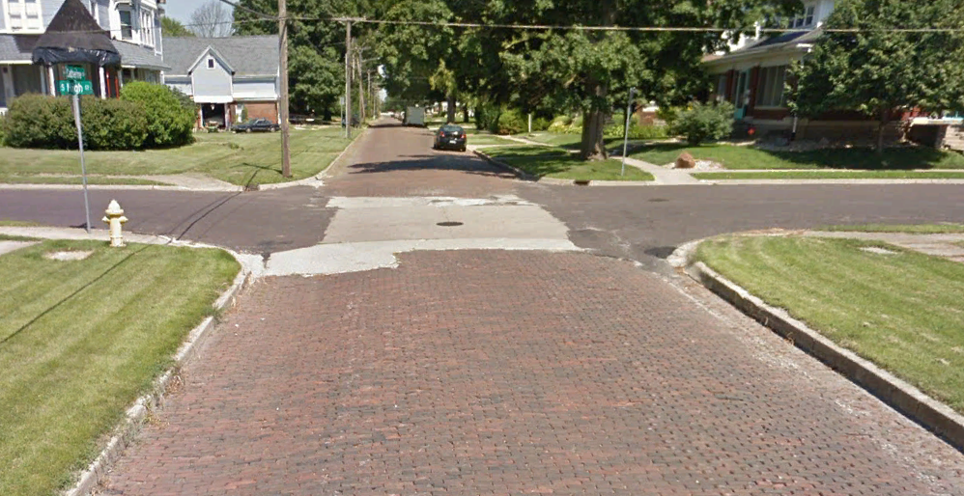
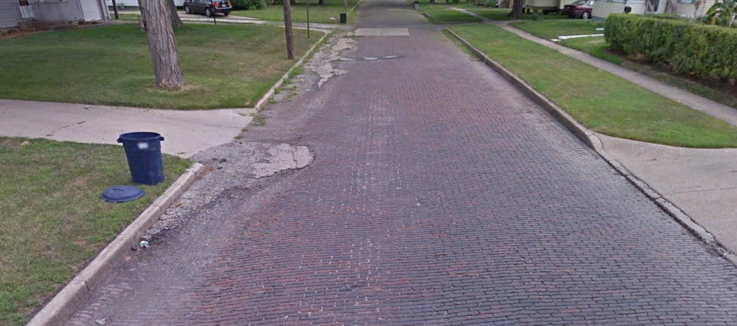
Catherine Street – (2-3 Projects) Design Begins FY 23/24
New Watermain
New Storm Sewer
Would drain through a priority project.
Brick or Asphalt?

Slide 54
Water Tower 3 90% Designed
Potential Location

Slide 55
N. Cummings Watermain Upgrade Designed – Waiting on Water Tower 3
Overview
Project Details
Increase Main Size
Needed for Water Tower 3
Increase water supply to Freedom Corridor

Slide 56
Lakeshore Drive Extension Phase 1 Design approved by IDOT
Overview
Project Details
Signalize Intersection with Business 24
New Storm Sewer
Open Corridor for Development

Slide 57
STP2 and STP1 Consent Order
STP 1 was primarily used to treat and discharge during wet weather events.
STP 2 had Water Quality discharge violations – This Triggered the Consent Order
Future Compliance
Implement a second series of improvements (Phase II) which will allow the city to abandon STP1.
Build a second oxidation ditch, 3rd clarifier, and sludge dewatering system by December 31, 2014.
STP 1 Decommissioned by December 31, 2017

Slide 58
Consent follow through
IEPA Mandate to decommission STP1 and upgrade STP2
(2013)
Washington Tornado
(11/2013)
STP 1 Decommissioned
(2020)
Phase 2A out for bid
09/2013
Phase 2A completed
(2018)
Strand begins preliminary study for Phase 2B (2016)
Strand shares Draft 2B report with staff
(2017)
Completed Preliminary Study for Phase 2b
(2019)
Due to the tornado, the IEPA allowed for an extension to the completion date of the Phase 2A and decommissioning.

Slide 59
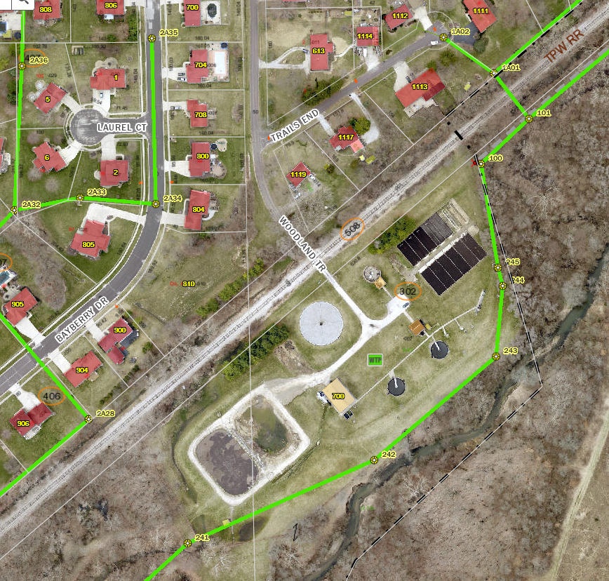
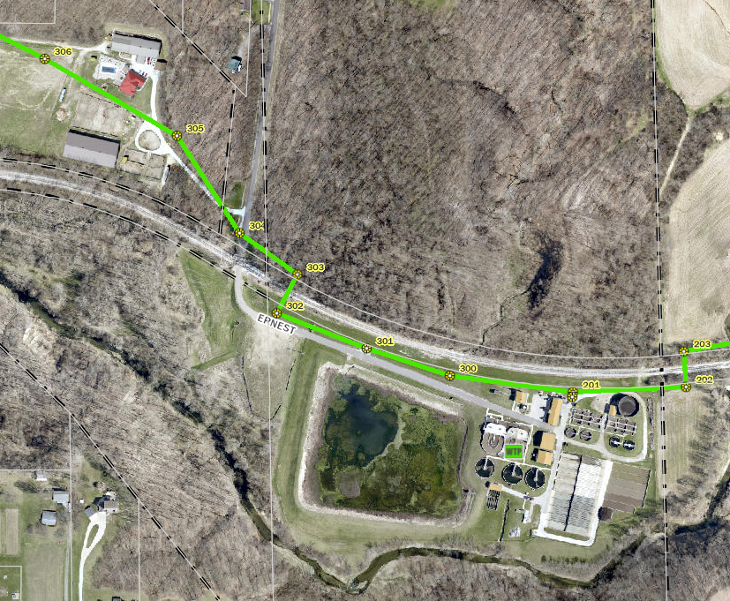
Phase 2B Existing trunkline Where?
STP 1
STP 2

Slide 60
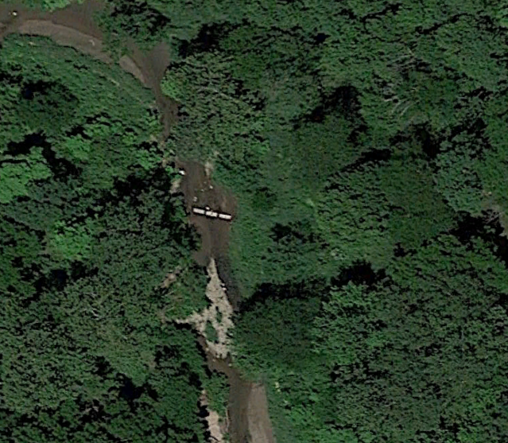
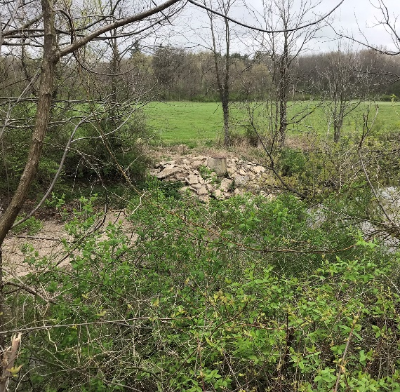
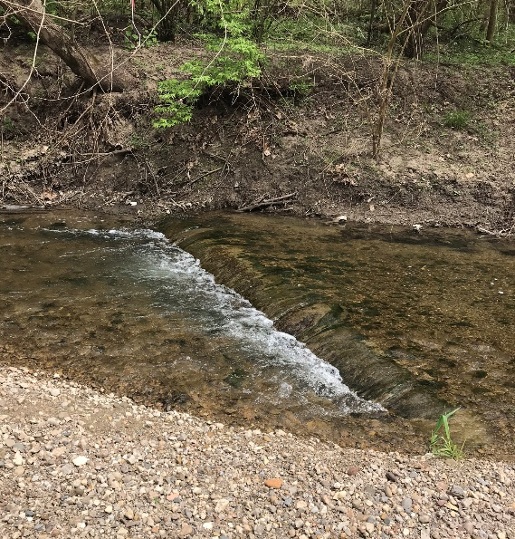
Phase 2B Why?
Existing Trunkline can’t convey all of STP 1 flow to STP 2 during wet weather.
City has a large Inflow and Infiltration Problem
Washington is not alone
I&I is huge problem for older Cities
Existing trunkline sits inside the flood influence of Farm Creek
Pipe exposed in creek
Manholes in creek
Access issues to existing trunkline

Slide 61
Phase 2B Why?
Existing Trunkline can’t convey all of STP 1 flow to STP 2 during wet weather.
City has a large Inflow and Infiltration Problem
Washington is not alone
I&I is huge problem for older Cities
Existing trunkline sits inside the flood influence of Farm Creek
Pipe exposed in creek
Manholes in creek
Access issues to existing trunkline

Slide 62
Phase 2B when?
Strand contracted to design the conveyance system for all STP1 flow to STP2 in 2016.
Strand looked at numerous alignments but initially showed two to staff in a draft preliminary report in 2017.
An Alignment South of RR ($7.8 million) and an Alignment north of RR ($7.95 million).
Influent Pumping Station needed regardless of alignment ($2.8 million)
Strand completes preliminary study in 2019.
Council approves southern alignment in 2019. Strand begins final design for trunkline.
Kaskaskia contracted to perform land acquisition services after Phase 1 completed.
Kaskaskia sends out introduction letters

Slide 63
Phase 2B HOW?
Upon receipt, Pudik family begins lobbying at council meetings
Pudik family hires Aptim to review multiple alignments.
Strand presents at a COW meeting to show all the alignments they actually reviewed.
Pudik family calls IEPA and Army Corp to voice their discontent causing permitting to stall and become more labor intensive.
Pudik family requests council hire third party firm.

Slide 64
Phase 2B HOW?
Hamilton hired to review alternatives (2021).
Hamilton recommends either remove I&I or move forward with Strand Alignment.
Robinson smoke tests the worst/oldest I&I contributors upstream of STP1. (2022)
Smoke testing doesn't show enough I&I removal from public sources
Hamilton review placed on hold
Council approves Archaeological review for permitting.
Can’t do archaeological study in winter and now some property owners aren’t allowing entrance.
Hamilton to update draft report (2023).

Slide 65
Phase 2B how much?
Using CPI Inflation - $10.6 million in Oct 2019 is $12.5 million today.
$10.6 million in 2020, Interest Rates were sub 2% - Total Cost for Bond $13 million
$12.5 million today, Interest Rates are near 5% - Total Cost for Bond $19.8 million
Strand Contract was $945,000 ($10,000 remaining)
Hamilton Contract was $165,000 ($66,000 remaining)
Robinson Contract was $139,000 (0ver $230,000 for remainder of City)
Kaskaskia contract was $14,000 ($7,000 remaining)

Slide 66
Infiltration and Inflow (I&I) Sanitary Sewer Evaluation Study (SSES)
Detection Methods
Public Sources
Smoke Testing
Dye Testing
Manhole Inspections
Televising
Private Sources
Smoke Testing
Lateral Defects
Cleanouts
Downspouts
Lateral Launch
Lateral Defects
Foundation Tiles
Home Inspection
Sump Pump Connection
PW Staff performs televising and manhole inspections in house

Slide 67
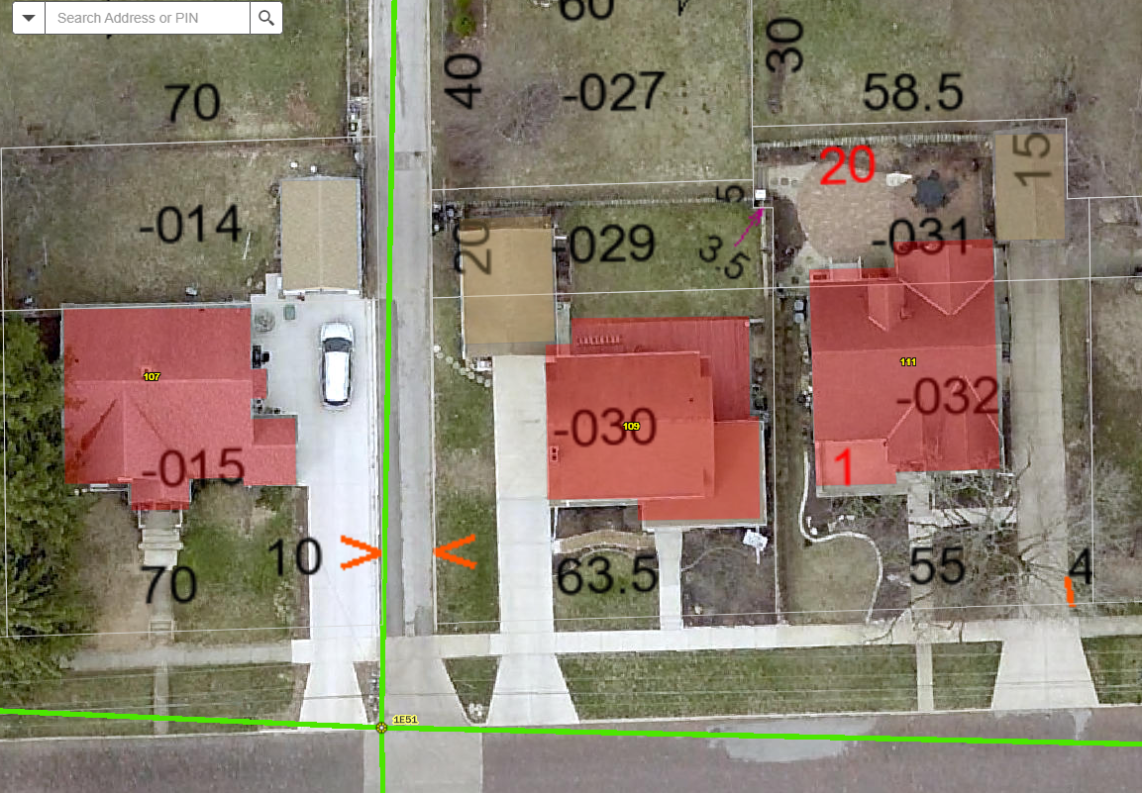
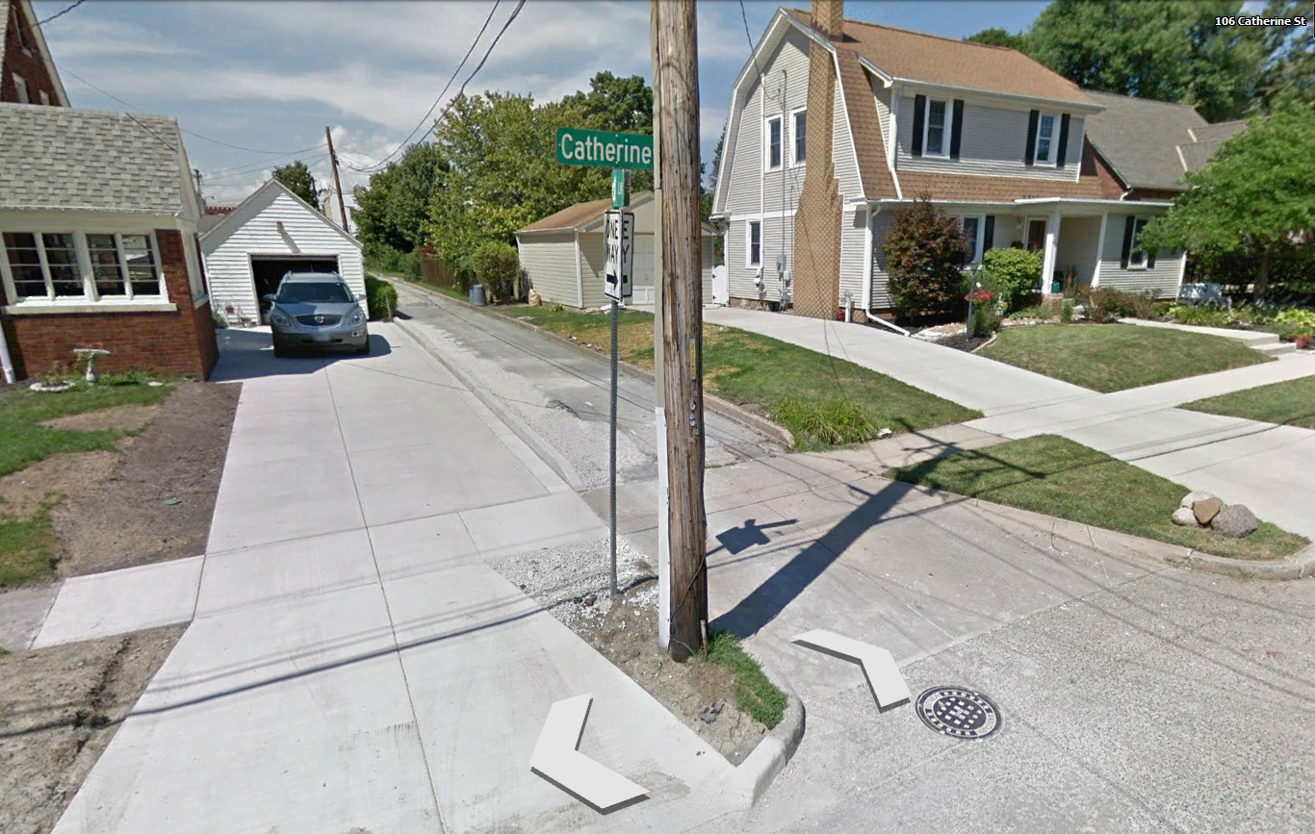
Phase 2B I&I Removal
Public
Private
The City budgets around $250,000 to line our mainlines.
City Staff repairs issues with manholes if identified during inspection
Houses built after 1920 likely have a foundation drain or footing tile.
Houses built mid to late 1950’s started running drains to a sump pump.
If house doesn’t have a sump pump, it likely has a foundation drain tied into the sanitary sewer.
If tie-in is near a basement floor drain
Tear up basement floor to add sump pump
If tie-in is along perimeter of home
Excavate, disconnect, add exterior sump pump.

Slide 68
Public Works
Director of Public Works
Brian Rittenhouse
Distribution & Collections Supervisor
Derek Hackney
Water Treatment Plant Supervisor
Tim Randall
Wastewater Treatment Plant Supervisor
Brad Powers
Street Supervisor
Brandon Vermillion
Foreman
Cory Cooper
D/C Laborer
Brogan Brownfield
STP Laborer
Mark Feeney
Street Laborer
Tom Bessler
Foreman
Jason McCombs
Operator
Nate Burchette
D/C Laborer
Ross Neaville
D/C Laborer
James Stanley
Street Laborer
Joel Dunbar
Mechanic
Todd Baker
WTP Laborer
Christian Lane
STP Laborer
Mike Rogers
D/C Laborer
Grant Snow
Street Laborer
Roger Greenway
Street Laborer
Matthew Hathcock
STP Laborer
Ryan Pfeifer
Street Laborer
Matthew Gough
Street Laborer
Connor Lee
Street Laborer
Chad Tysinger

Slide 69
Public Works
Routine Preventive Maintenance
Sanitary and Storm Manhole Inspections
Sanitary and Storm Main Cleaning and Inspections
Storm Inlets, Outfall and Basin Inspections
Water Valve Inspections and Exercising
Hydrant Flushing and Inspections
Street, Sidewalk and Curb Inspections
Facility Maintenance
Fleet Maintenance

Slide 70
Police Department
Chief of Police
Michael McCoy
Deputy Police Chief
Jeff Stevens
Investigation Sergeant
Steven Smith
1st Shift Sergeant
Brian Simpson
2nd Shift Sergeant
Josh Sutter
3rd Shift Sergeant
Jacob Cernek
Swing Shift Sergeant
Ryan Hunsinger
Admin. Assistant
Linda Storer
P/T Sergeant
Brad Marshall
Lyle Baele
Detective
Steven Hinken
Officer
Zach Bean
Officer
Dan Althiser
Officer
Kelley Noetzol
Admin. Officer
Bethany Duley
In Training
Joseph Dubois
Detective
Jeff Hensley
Officer
Michael Brown
Officer
Ben Gregory
Officer
Ashley Peto
Admin. Specialist
Rebecca Harper
Courtney Williams
Sherry Guimond
School Resource Officer
Troi Westbrook
Officer
Daniel Foster
Officer
Ron Moore
Officer
Tanner Stockton
P/T Police Officer
Ron Brinker
Justin Casey
Cory Herron
Josh Jeffries
Randy Schweigert
CRO
Dramane Taylor
Officer
Derek Thomas
Officer
Henry Perrilles
Officer
Nathan Thompson
P/T Admin.
Specialist
Mara McCarthy

Slide 71
How to Get Along With Other Council Members
Anne Heinze Silvis
University of Illinois Extension
asilvis@illinois.edu

Slide 72
What is conflict?
At least two parties.
Involves a struggle, threat (real or suspected), or fear of loss.
Interaction or interference.
May be emotional.

Slide 73
What is conflict?
Conflict can also be an opportunity for change, improvement, new understanding, attention to a problem or opportunity.

Slide 74
A short list to remember:
Conflict happens. It’s normal.
Control the situation by thinking through your perceptions and actions.
Foster communication.

Slide 75
Use only unconditionally constructive strategies . . . .
“Do only those things that are good for the relationship and good for us; whether or not they reciprocate.”
Getting Together
By Roger Fisher and Scott Brown

Slide 76
Why does conflict happen?
Situation.
Personal differences.
Cultural differences.
Faulty communication.

Slide 77
What can you control?
Your thinking.
Your perceptions and judgments.
Your behaviors.

Slide 78
What is beyond your control?
EVERYTHING ELSE!
Including another person’s thinking, judgments, and behavior.

Slide 79
"Those disputing, contradicting, and confuting people . . . get victory, sometimes, but they never get good will, which would be of more use to them."
Benjamin Franklin

Slide 80
Your goals . . . .
Work on understanding the other person’s perspective.
Clarify the real issues.
Keep the conversation going!
(Especially considering the alternatives!)

Slide 81
“Darkness cannot drive out darkness; only light can do that. Hate cannot drive out hate; only love can do that.”
Martin Luther King, Jr.

